Slide 1
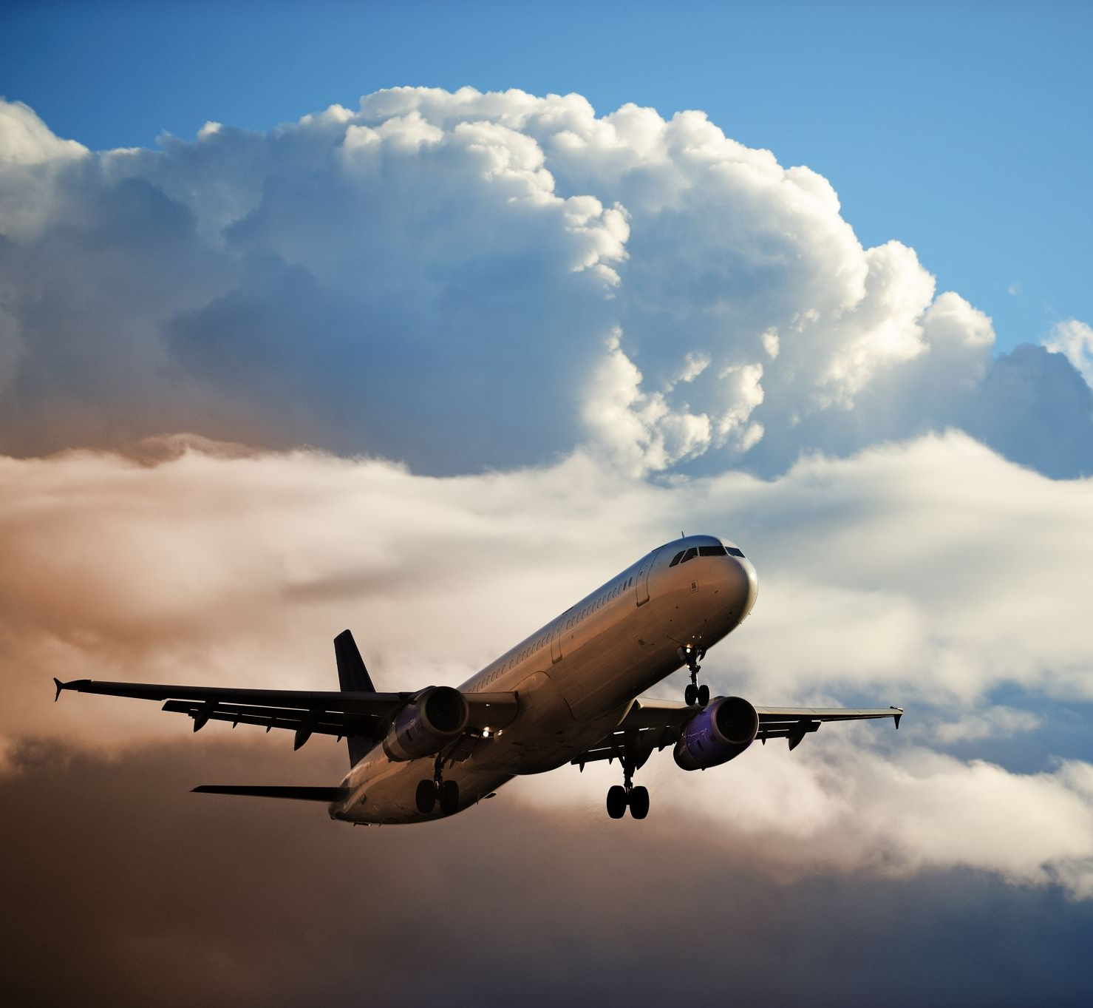
Lufthansa Airlines Safety promotion
Shaquiel Pashtunyar
DSC640

Slide 2
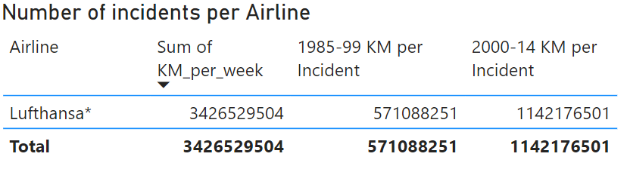
Luftansa’s incident record is in decline
Over the last 2 decades we have seen less incidents and have flown more miles without issue

Slide 3
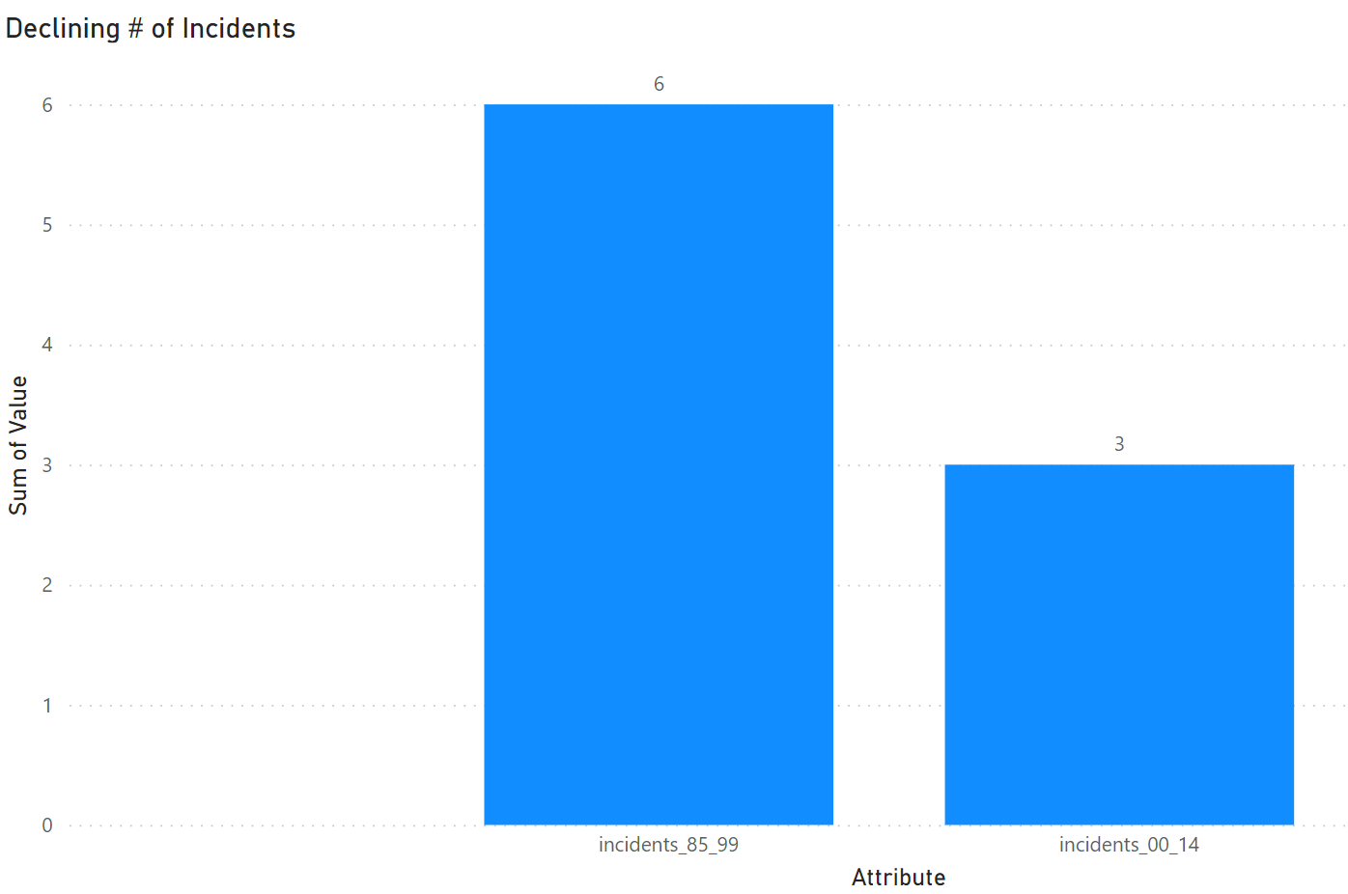
Incidents are at a record low
We went from 6 incidents down to 3 while upping the number of miles we travel

Slide 4
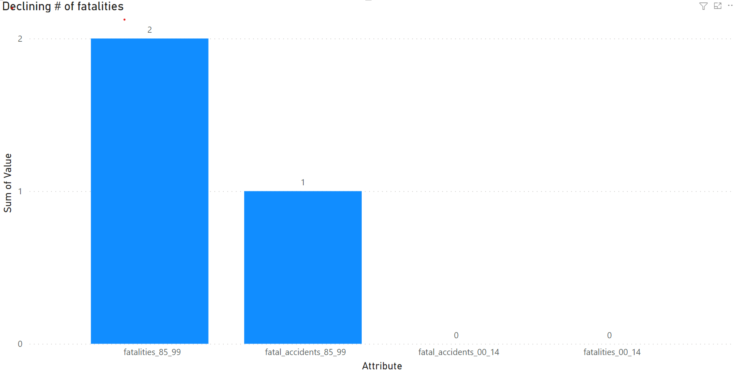
We also are seeing a decline in fatalities
In the recent years we have also seen no fatalities on our flights, which is a huge improvement on our part

Slide 5
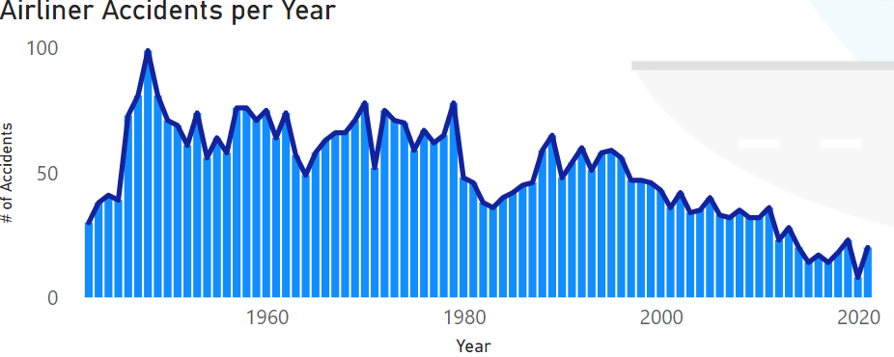
Trends in the entirety of aviation
Overall, we are seeing less and less airline incidents over the years. This is largely due to advancements in aeronautic safety and technology

Slide 6
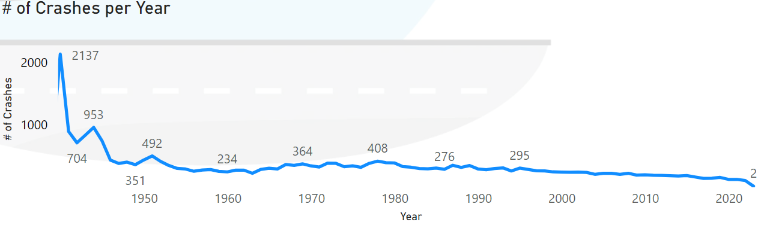
Number of crashes
The entire airline market has seen less and less crashes and this is with the enormous increase in mileage

Slide 7
Summary
In conclusion, aviation isn’t getting worse with the recent crashes. We have seen trends showing the number of accidents and incidents going down year after year
We also see that Lufthansa as an airline has gone miles with less and less incidents and no fatalities in the recent decades. This is contrary to public notion.
A reimaging campaign will likely be needed to help get the word out on our safety initiatives to help encourage people to trust in Lufthansa, but the data shows we are trending in the right direction.

